Slide 1

Exercise

Slide 2
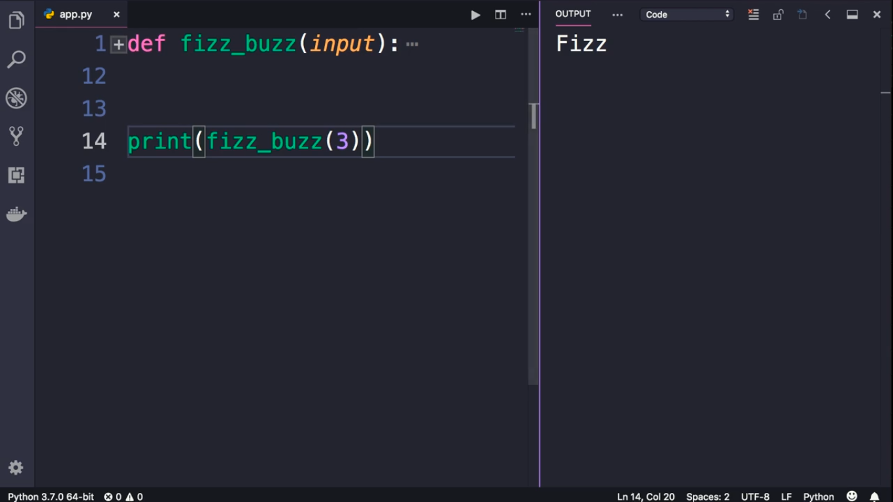
If the Input was divisible by 3, the function return “Fizz”

Slide 3
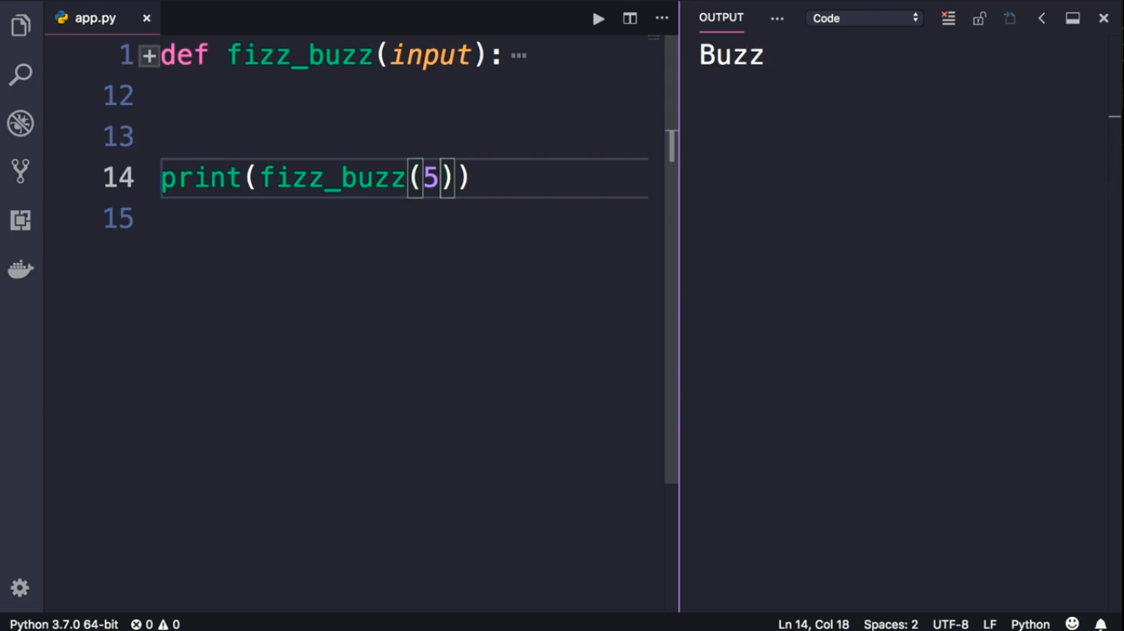
If the Input was divisible by 5, the function return “Buzz”

Slide 4
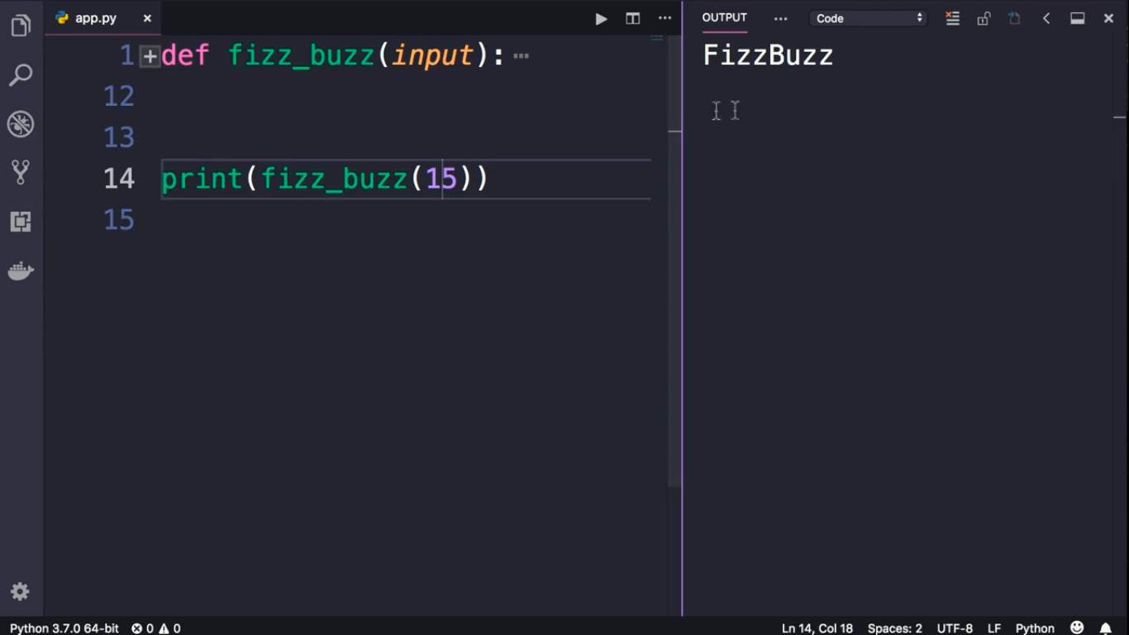
If the Input was divisible by both 3 and 5, the function return “Buzz”

Slide 5
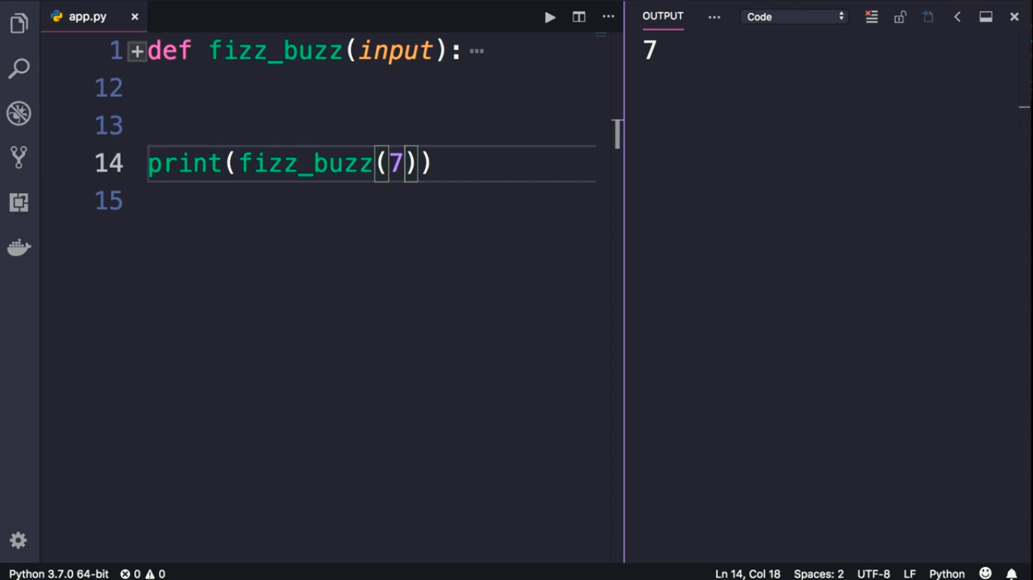
For any other number,
the function return the same input

